Slide 1
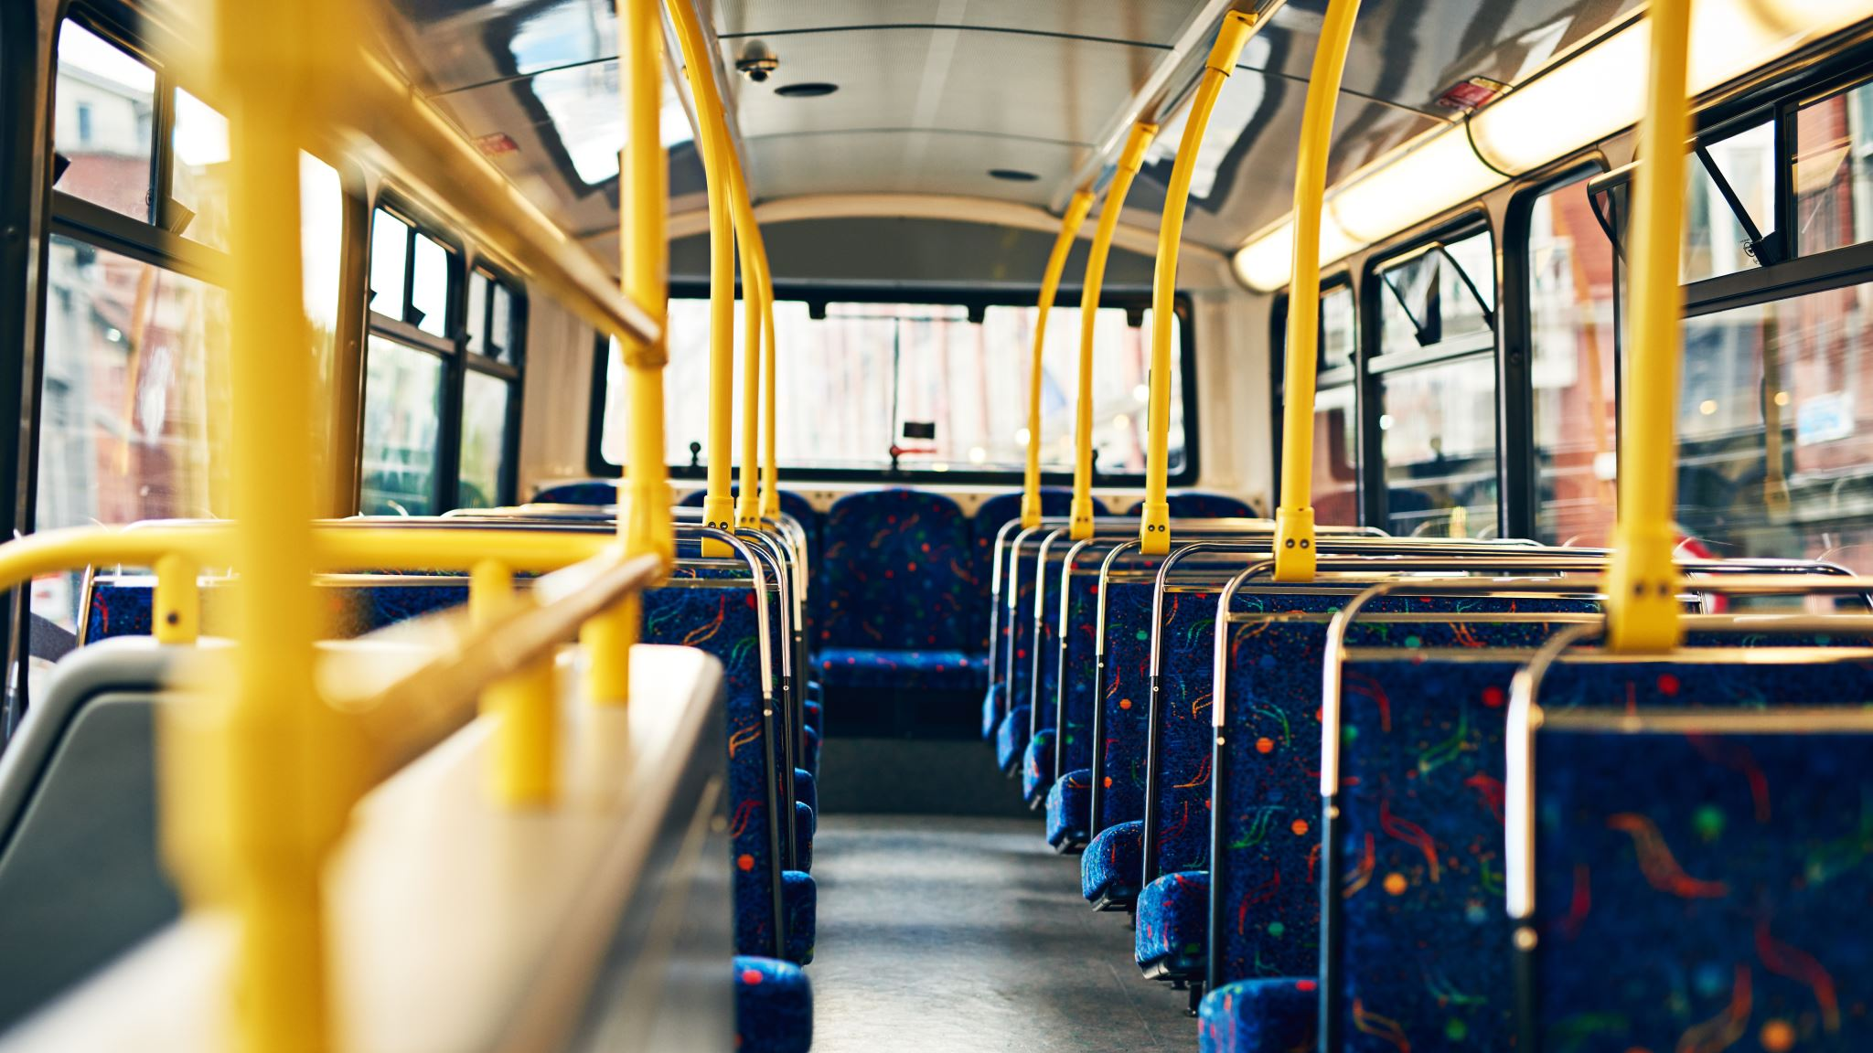
BUS RESERVATION SYSTEM
PRESENTED BY
ALLA OM SRI AMRUTHA VARSHINI (46289889)
POTTA LAKSHMI RAVALI (46289888)
GORANTLA SARANAYA (46281781)
VANAPALLI BHARGAVI (46282517)
VUDUMULA TEJASWI (46282516)
REPALLE JYOTHI SWARUPA (46294685)

Slide 2
CONTENTS:
INTRODUCTION
OBJECTIVE
TECHNOLOGIES REQUIRED
MODULES
FLOW CHART
UML DIAGRAM
1. USE CASE DIAGRAM
2. SEQUENCE DIAGRAM
WORKING
TOOLS
FEATURES
OUTPUT
CONCLUSION

Slide 3

INTRODUCTION:
In this bus reservation system, you can store the bus details and user details, we can view the bus details according to the destination or using PNR number or using the name of the bus.
Only admin can add buses and do the reservation. User can login to the portal and he can book a ticket, view ticket and will be able to check the availability of seats particular bus, whether seats are reserved or not. Users are able to see the status of available buses.

Slide 4


OBJECTIVE:
The main objective of this project is to make ticket booking easier, this system will lead to increase in the efficiency of ticket booking for the users.
This project is made as user friendly as possible so that every one can use it with little knowledge of system computers.
This project is simple & reliable. More-over less time consuming as compared to manual work.

Slide 5
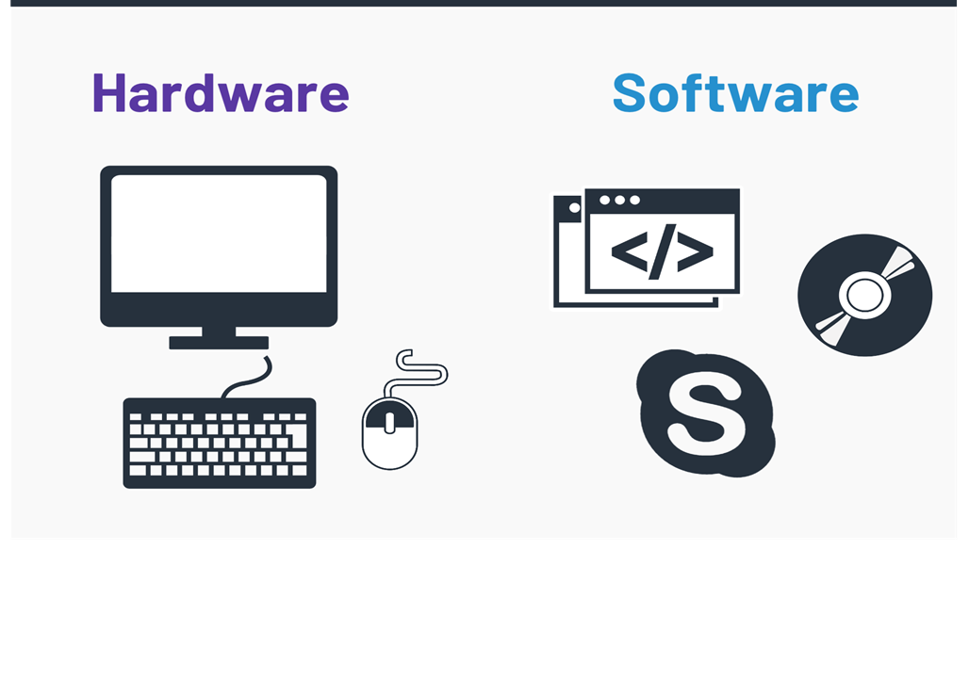
HARDWARE & SOFTWARE
C++ language
Ubuntu/Linux terminal​
System with i3 processor.

Slide 6
MODULES
This application mainly has two modules:
Admin:
Admin is the person login with his login credentials. He manages the bus details like add bus, view bus details, edit bus, delete bus & view booking menus.
User:
If the user is using the application for the first time then he/she has to register then only user can book the ticket.
If the user is already an existing user, then he/she has to login with his/her login credentials. If username or password is not valid then he/she has to login with valid details to enter the user portal. After that he/she can book the ticket.
User can cancel ticket or view ticket or edit his/her details.

Slide 7
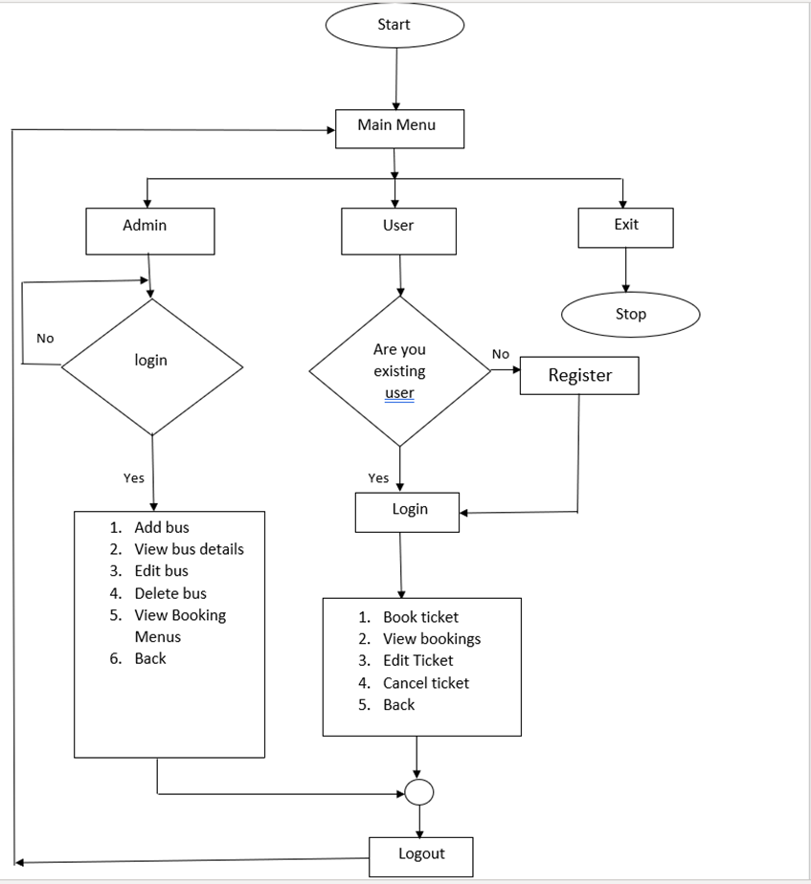
FLOW CHART

Slide 8
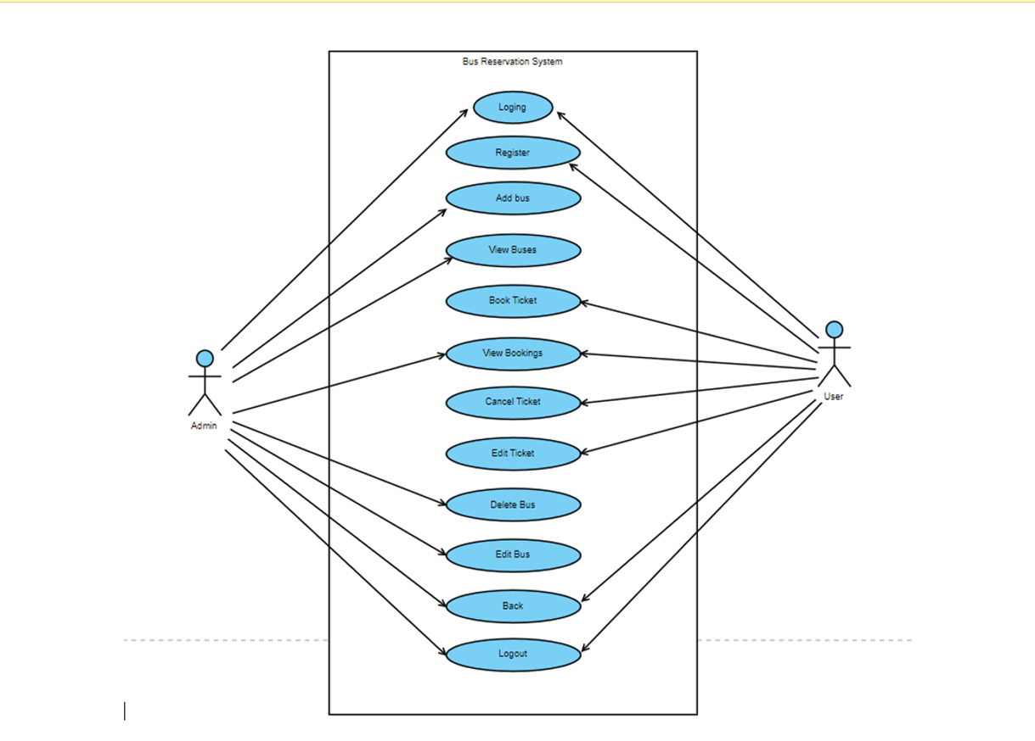
USE CASE DIAGRAM

Slide 9
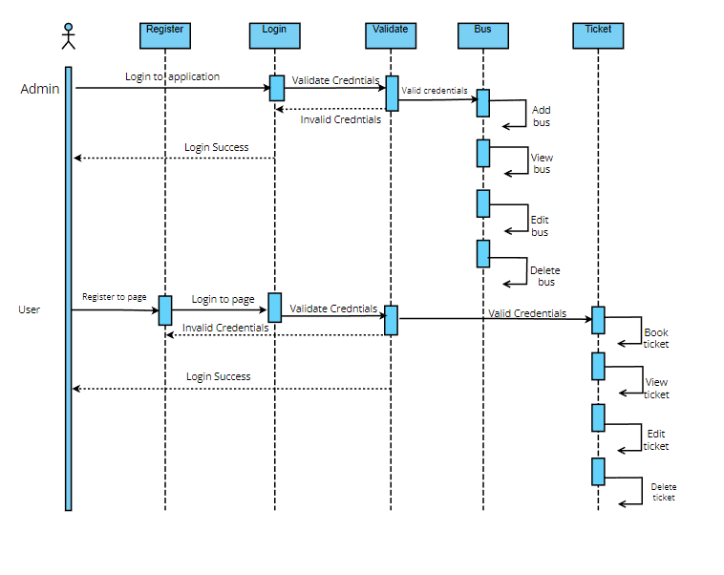
SEQUENCE DIAGRAM

Slide 10

WORKING
Admin:
Add Bus
View Bus Details
Edit Bus
Delete Bus
View Bookings Menus
Back

Slide 11
WORKING
User:
Book Ticket
Back
View Ticket
Edit Ticket
Delete Ticket

Slide 12

TOOLS
VALGRIND:
It is memory checking tool to detect memory leaks and it majorly focus on dynamic memory.
SPLINT:
Static analyzer which helps programmer in find possible errors in program without having to compile or executing the program.
MAKEFILE:
Tool used for run and compile program automatically in more efficient way.
C++/CPP Unit testing:
Unit testing is used to test a particular unit of code or a particular function .
IT testing:
IT testing is used to test for enter code after the integration is done.
Gcov:
Gcov is a source code coverage analysis and statement-by-statement profiling tool. Gcov comes as a standard utility with the GNU complier collection suite.

Slide 13
FEATURES:
We can view or check the bus details with PNR number, By Source, By Destination and By the name of the Bus.
User can book many tickets for available buses.
PNR number will be different for every user so that it is easier to view the ticket.

Slide 14
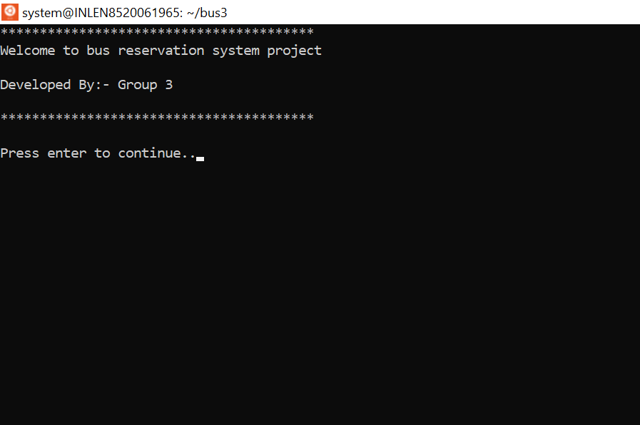
OUTPUT

Slide 15
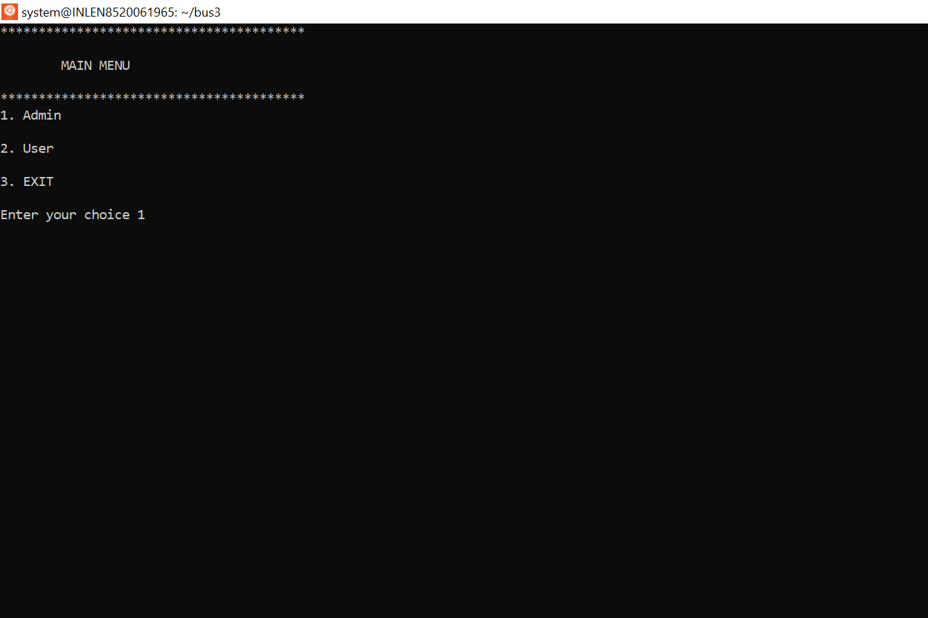
OUTPUT

Slide 16
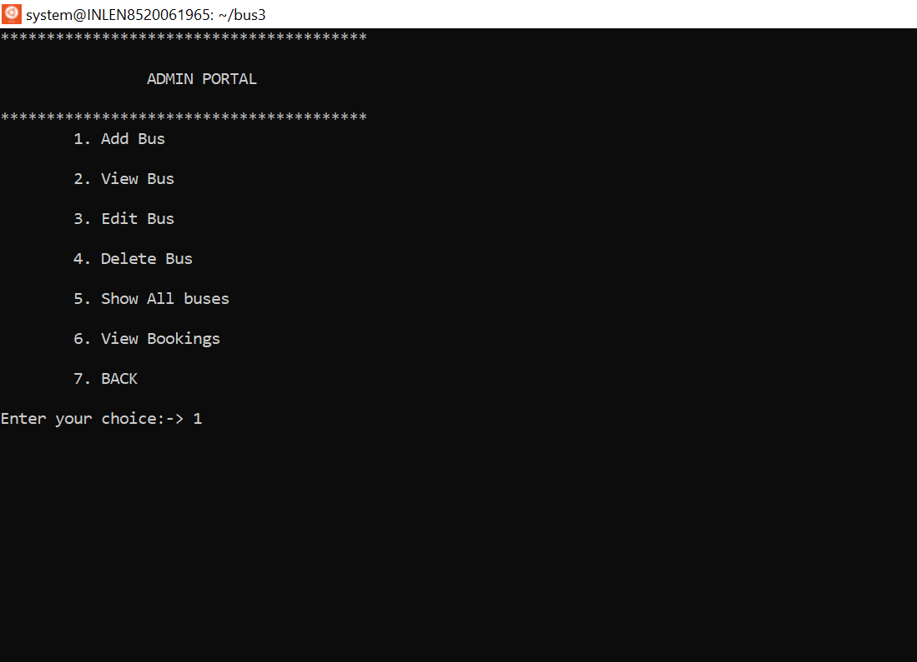
OUTPUT

Slide 17
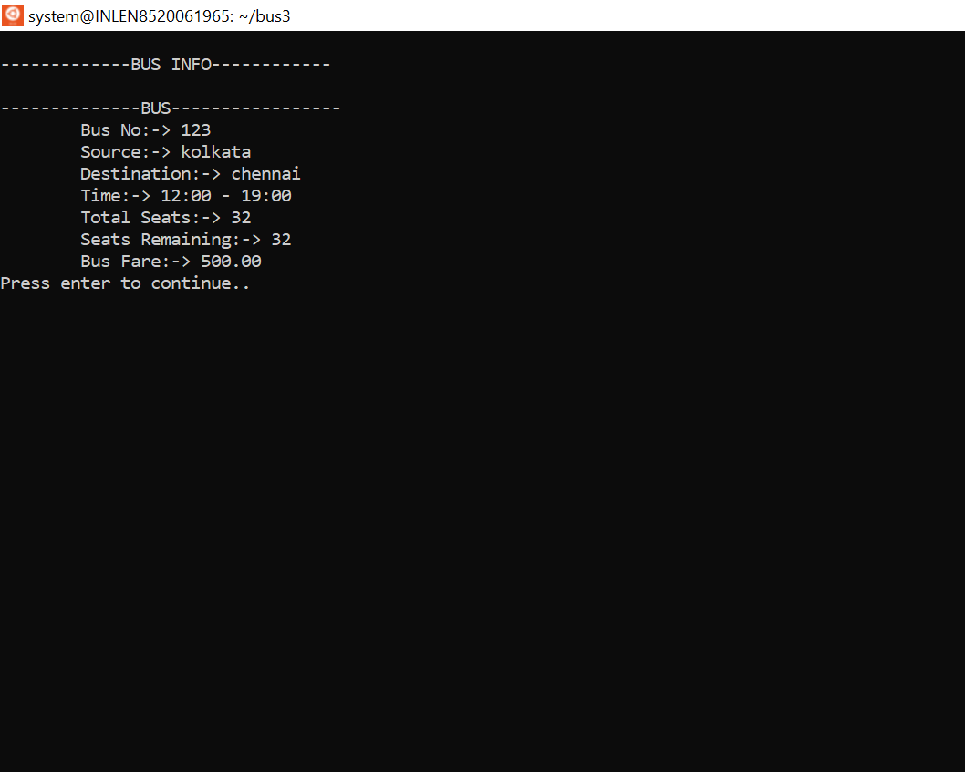
OUTPUT

Slide 18
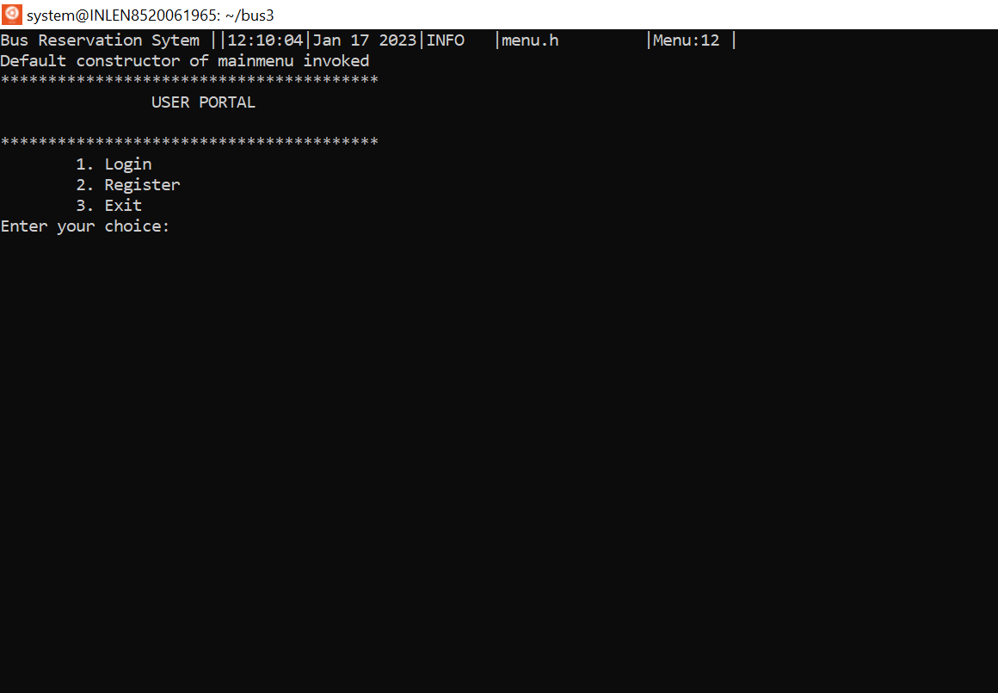
OUTPUT

Slide 19
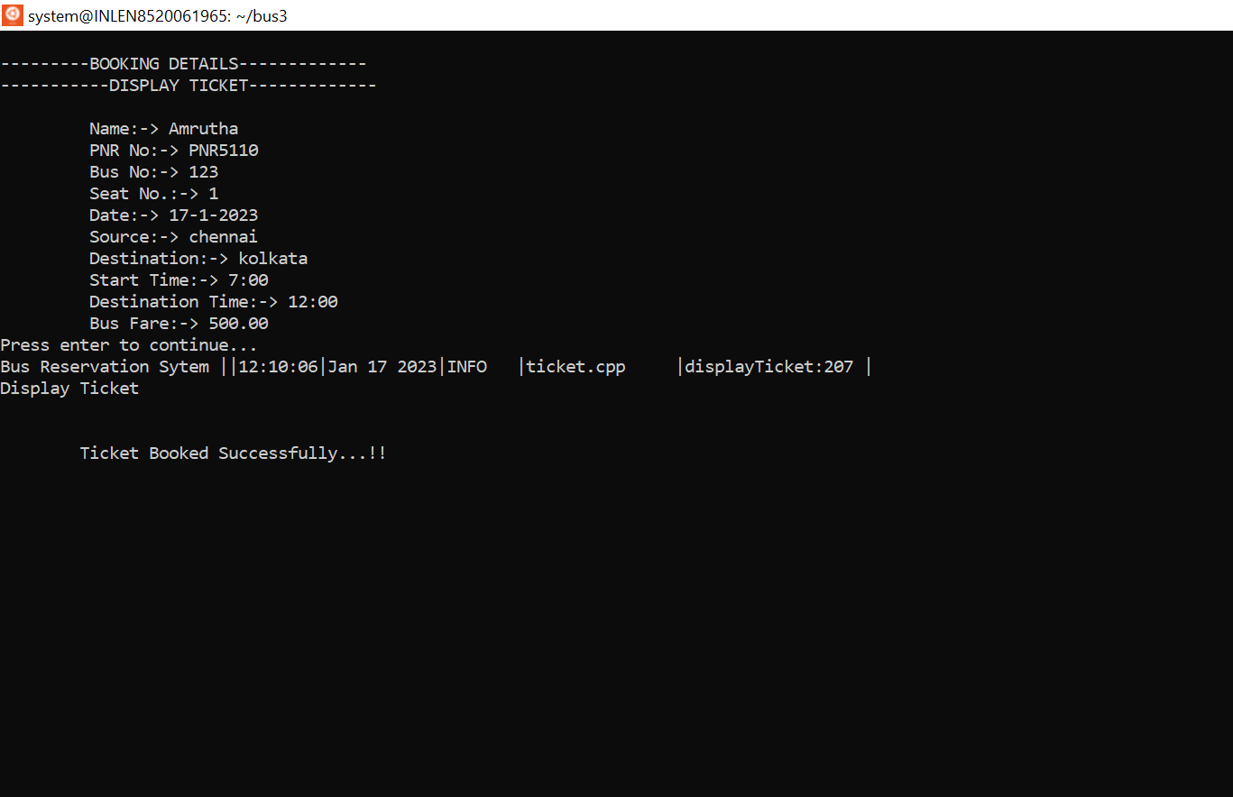
OUTPUT

Slide 20
ADVANTAGES & DISADVANTAGES:
ADVANTAGES:
It is open 24/7 hours for reservation.
It is commission Free.
Good customer service.
Clear and simple process.
DISADVANTAGES:
You need to be ready for an influx of new customers

Slide 21
CONCLUSION:
In this project of Bus Reservation System we mainly have two actors admin and user. Admin will manage all the details regarding the bus.
The user will be able to book ticket and he/she can view the availability of seats. Here we’ll use file handling so that the date of previous user won’t get lost/deleted. Make use of inheritance wherever it is required.

Slide 22


